Slide 1
Operating Instructions for ROFES/MONICOR software
Technology and Operational Details of the ROFES software
Professional
Biological Feedback Corrections
Notes:
After starting the slide movie press F5 and study the contents of the slides by left clicking for the change of slides.

Slide 2
Correction of stress states. Diagnostic and biofeedback corrections
4 cases
Case 1
“Patient's functional frequencies” - these are individual-specific endogenic frequencies of the person

Slide 3
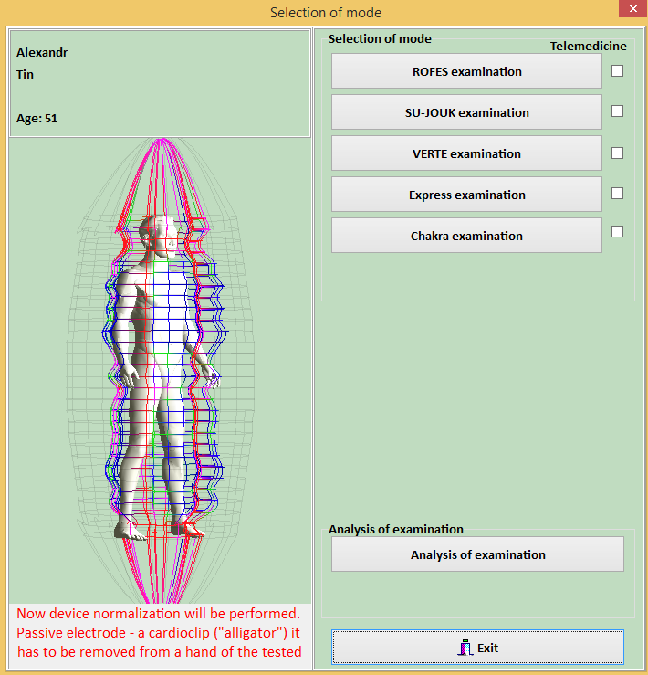
Patient's functionary frequencies
Perform patient diagnostics using one of the methods to obtain electrophysiological (energy flow) imprint.(“ROFES/Su Jok measurement”, “Verte measurement”, “Express measurement”) For example: ROFES measurement + Express measurement by the one point .
For more detail please see a slideshow: “Working with the ROFES software - Diagnostics module.pptx”
For further correction of the patient condition, color therapy, press button “Analysis of examination”

Slide 4
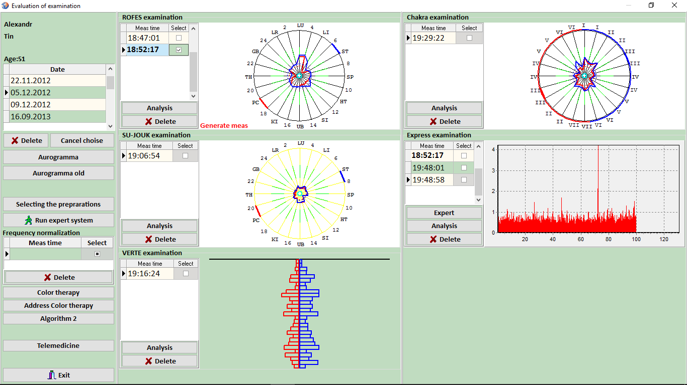
Patient's functionary frequencies
A screen Patient Health Record opens up
Select the utilized diagnostics method by ticking _V_ in the column “Selection” in a screen “Evaluation of examination”.
Then click button “Run expert system” to go to Expert System.

Slide 5
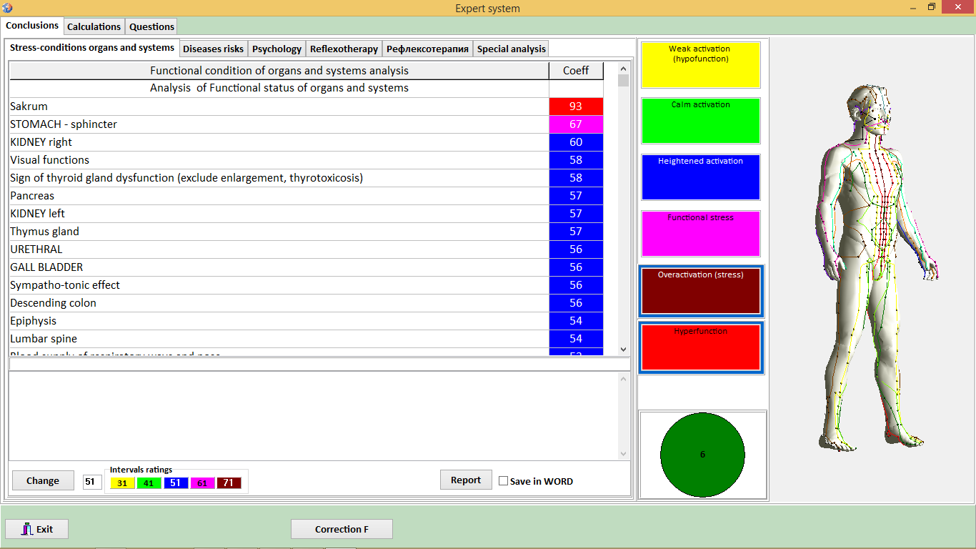
Patient's functionary frequencies
The screen “Expert System” opens up
The “Expert System” operation is detailed in Diagnostics module.pptx
The program automatically clips light-weighted coefficients, leaving 44 of the most heavy-weighted, calculated from three tabs.
Then click “Correction F” button

Slide 6
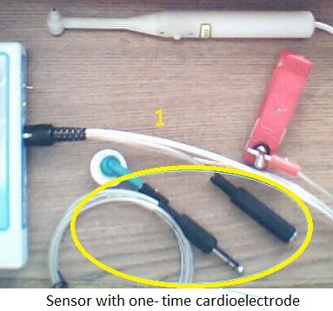
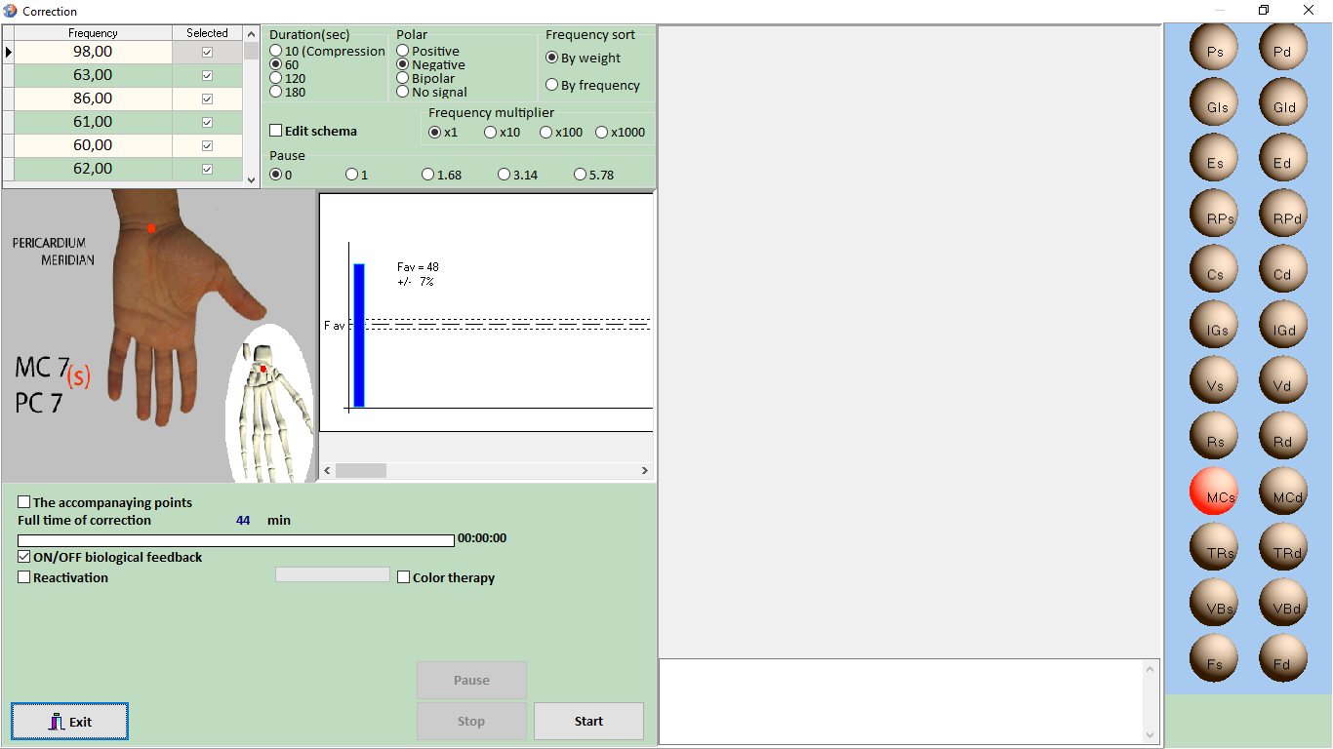
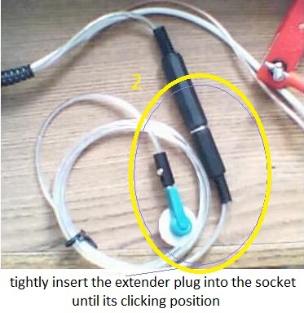
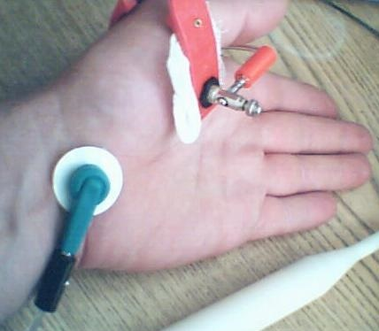
Patient's functionary frequencies
The screen “Correction” opens up
The timing for correction of stress - states for is from 20 to 44 minutes for adults, increasing one minute daily. For children aged 10 and older, increasingly up to 30 minutes. The cut-off line allows achieving such setting using “1 frequency = 1 minute” rule.
"Key point" is indicated on the picture in the center, is is determined by the Diagnostics process. This "Key point" is the most effective point
for correction of stress – states.
Then click the button “Start”.
"If extension cable is provided, connect the extension cable to the “ЭХП - (ECS)” sensor by inserting the plug into the socket of the “ЭХП - ECS” sensor, located on a short wire (tightly insert the extension cord plug into the socket until it clicks, see Fig. 1).
Install a disposable on a key point as shown on Fig.

Slide 7
Patient's functionary frequencies
“Color therapy” mode. In combination with “Correction” mode, Color therapy” intensifies the effect of correction of the patient stress -states.
Click on “Color therapy” button. - Sign _V_ will appear there.
The “Color therapy” mode will be initiated in parallel to the patient correction process by functional frequencies. Operation of the “Color therapy” mode is described in item 12 of the “Instructions on working with software ROFES/MONICOR”.

Slide 8
Correction of stress states Diagnostic and correction methods with biological feedback
Case 2
“Algorithm 2 Diagnostics and correction”
This is a correction by are exogenous body frequencies

Slide 9
External body frequencies for humans
Perform patient diagnostics using one of the methods to obtain electrophysiological (energy flow) imprint.(“ROFES/Su Jok measurement”, “Verte measurement”, “Express measurement”) For example: ROFES measurement .
For more detail please see a slideshow: “Working with the ROFES software - Diagnostics module.pptx”
For further correction of the patient condition, color therapy, press button “Analysis of examination”

Slide 10
External body frequencies for humans
A screen Patient Health Record opens up
Select the utilized diagnostics method by ticking _V_ in the column “Selection” in a screen “Evaluation of examination”.
Then click “Algoritm 2” button.

Slide 11
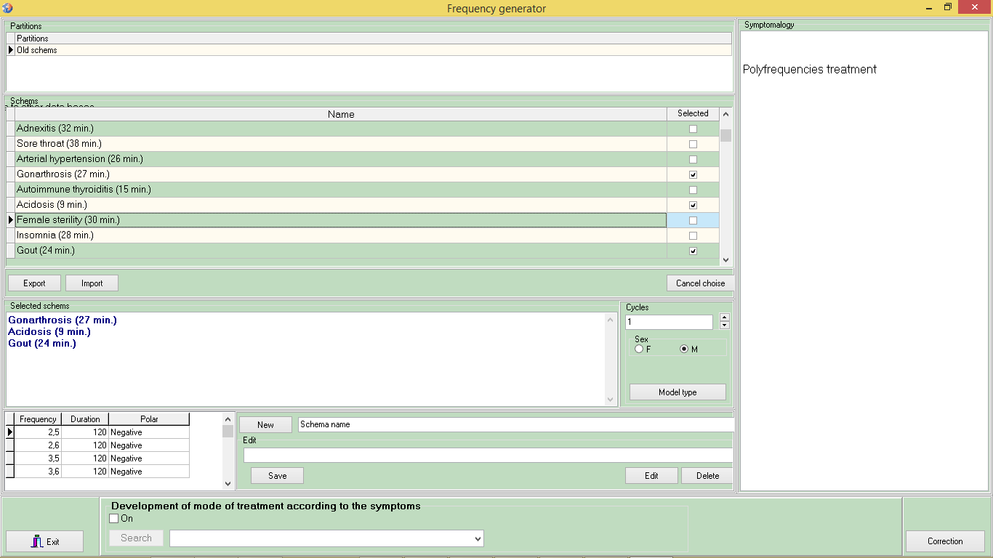
External body frequencies for humans
The Algorithm 2 allows to perform the stress states correction compensating their impact by BAP and human body zones on the simptomatic and syndromes basis.
The list of specific deseases, symptomology and syndroms, as well as mono frequencies is presented in the table. Their descriptions are in the text box on the right. By scrolling (paging), you can select the required mono and poly frequencies for the patient, corresponding to the results of syndrome-based diagnostics for biofeedback mode correction.
Then click “Correction” button

Slide 12
External body frequencies for humans
The screen “Correction” opens up
A picture with the identified “Key point” is located in the centre of the window. This point is the most effective specific location for frequency correction, accupuncture, or other stimulating measures.
Connect the sensor “ECS” extention cable as shown on Fig.1 and 2. Install a disposable cardioelectrode on “Key point"
Then click the button “Start”.

Slide 13
External body frequencies for humans
“Color therapy” mode. In combination with “Correction” mode, Color therapy” intensifies the effect of correction of the patient stress -states.
Click on “Color therapy” button. - Sign _V_ will appear there.
The “Color therapy” mode will be initiated in parallel to the patient correction process by functional frequencies. Operation of the “Color therapy” mode is described in item 12 of the “Instructions on working with software ROFES/MONICOR”.

Slide 14
The detailed information please see instructions for working with the software. 9.1. – 9.2. Items

Slide 15
Correction of stress states. Diagnostic and correction methods with biological feedback
Case 3
“Diagnostics and correction by the point, corresponding to pain syndrome in Su Jok and Corporeal methods”
- It is a correction by the individually specific endogenic frequencies

Slide 16
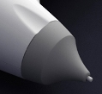
Diagnostics and correction by the point, corresponding to pain syndrome in Su Jok and Corporeal methods
Should there be a local pain syndrome in the body, the corresponding is Su Jok microsystem on a wrist is determined.
Please change the sensor cap for Su Jock.
Lunch one point “Express-diagnostics…” to get frequency reading from the point corresponding to local pain syndrome.

Slide 17
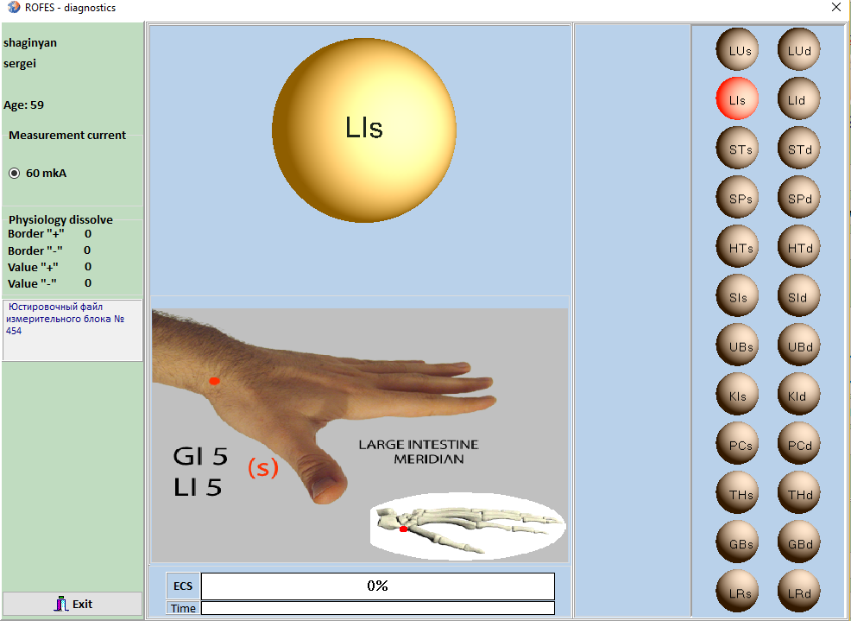
Diagnostics and correction by the point, corresponding to pain syndrome in Su Jok and Corporeal methods
Place the sensor to this point regardless of the points images offered by the “ROFES” program

Slide 18
Diagnostics and correction by the point, corresponding to pain syndrome in Su Jok and Corporeal methods
The screen “Correction” opens up automatically.
Upon completion of the diagnostics by the point of the pain syndrome, the ‘Correction’ screen opens up. This ‘Correction’ screen generates a correction signal calculated on the basis of patient specific individual (endogenous) frequencies. These endogenous frequencies include all the specific frequencies responsible for pain.
Please ignore the image with the point, offered by “ROFES” program
Then press the button “Start”.

Slide 19
Diagnostics and correction by the point, corresponding to pain syndrome in Su Jok and Corporeal methods
The point, of corresponding to the pain syndrome can be determined by patient body palpation. If there are no cutaneous findings in the point and the integrity of cutaneous covering is preserved, then a disposable cardioelectrode is placed there and the “Diagnostics and correction” procedure by one point shall be performed.
For example: Herniated intervertebral disc. Determine the point of pain syndrome
on a patient’s spine by palpation. Set a disposable cardioelectrode on the point of the pain syndrome.
Then press the button “Start”.

Slide 20
Correction of stress states. Diagnostic and correction methods with biological feedback
Case 4
Formulation of reflexotherapy (electrostimulating therapy) in accordance with patient’s symptomology and illnesses.
- these are individual human exogenous frequencies

Slide 21
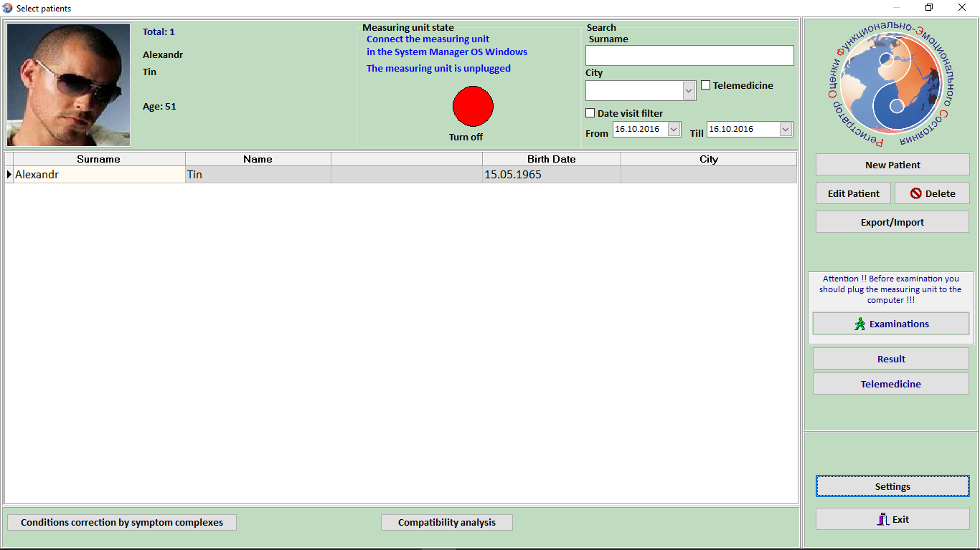
these are individual human exogenous frequencies
This function presumes a lack of a primary diagnostics in the existing “ROFES” methods. Accordingly, this function may be non-specific and could be run from the initial screen "Patient Selection".
Press the button “Correction of symptomology”.

Slide 22
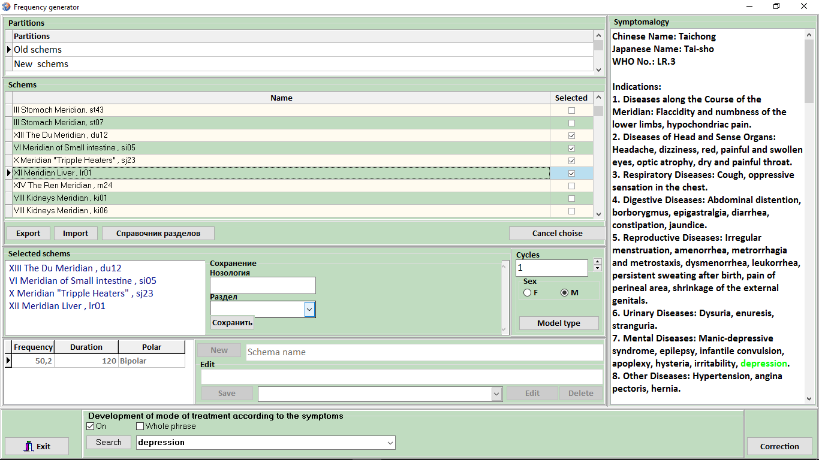
these are individual human exogenous frequencies
The screen “Frequency generator” opens up
Activate the mode below “Treatment formulation by symptomology" by ticking the box _v_ next to "On".
Enter the patient’s symptom into the text box of the classifier. If the symptom is a phrase, tick the box _v_ next to the “Exact phrase".
As an example let's take symptom "depression" for a male patient. Enter this symptom into the text box.
Them press
the button “Seach”

Slide 23
these are individual human exogenous frequencies
The program will display in the central table all meridians’ points, and specific frequencies, which contain a term "depression". In section "Indications" the word "depression" is highlighted in green
Upon analysis of symptomology, displayed in a table of Points of Stimulation and Frequencies, select the symptoms with the most relevant anamnestic data for the patient. For this purpose, tick the box _v_ in a column "Select".
With that the selected points and frequencies are transferred to the central table and highlighted with blue
Where to attach the electrodes?
For that press
button “Model Type”

Slide 24
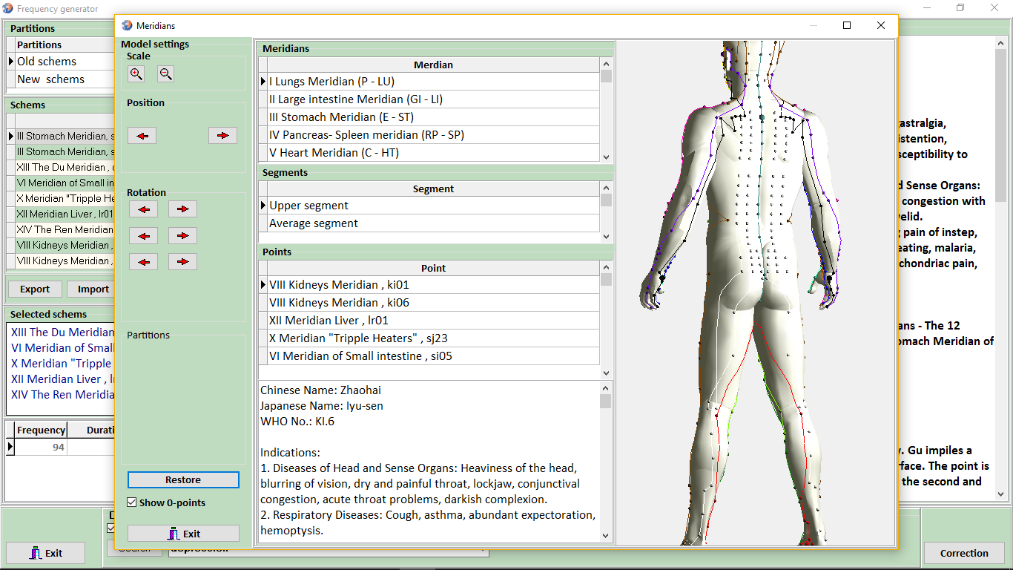
these are individual human exogenous frequencies
The screen “Meridians” opens up
3-D human model indicates locations of points, and the anatomical topology is indicated in the text box below at the activation of lines in the central table.
Apply the cardioelectrodes to the chosen points. If the selected points are located at the areas where stationary cardioelectrodes are hard to install, attach disposable cardioelectrodes to such locations.
Them click the
button “Exit”
Them click
the button “Correction”

Slide 25
For more detail please see a slideshow: Instructions for working with the software. 9.4. Items

